Slide 1
User stitching and analysis
By Arjun Sanchala

Slide 2
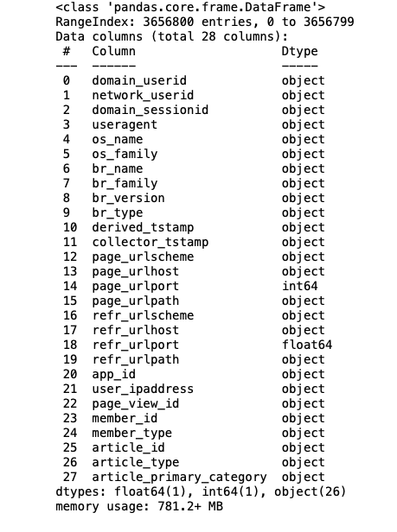
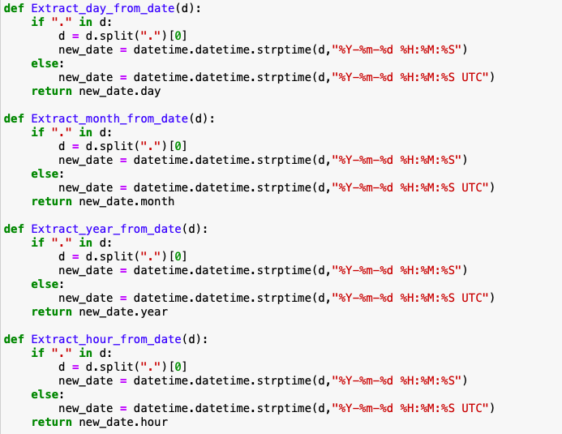
Data description

Slide 3
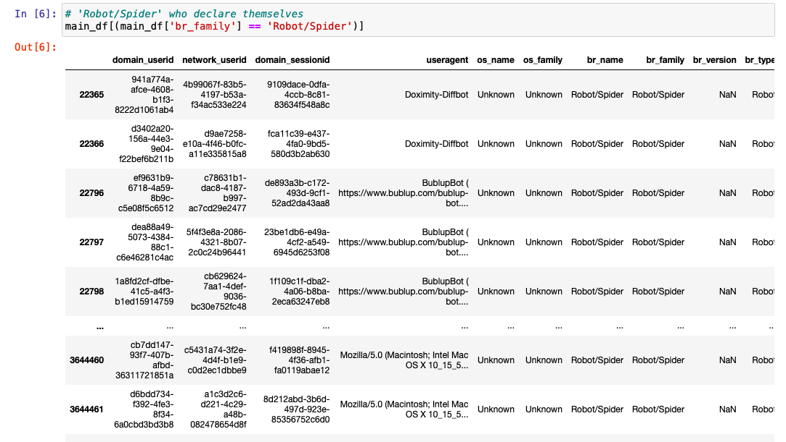
Robot/spider identifier

Slide 4
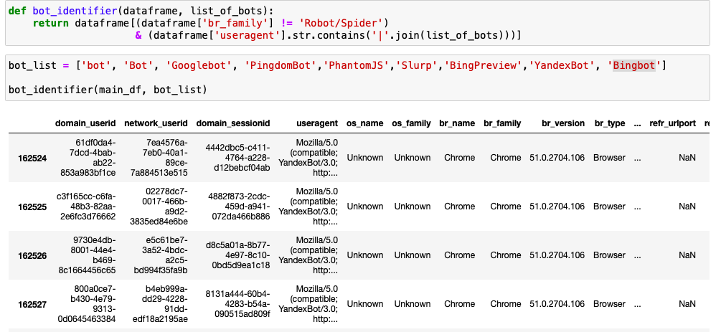
Python function to identify bots
1035 rows

Slide 5
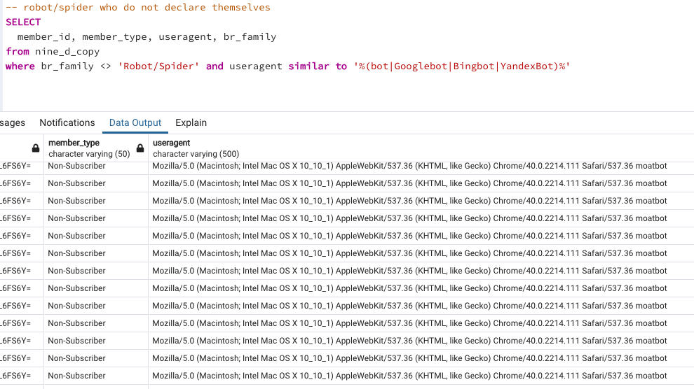
Postgresql query to identify bots

Slide 6
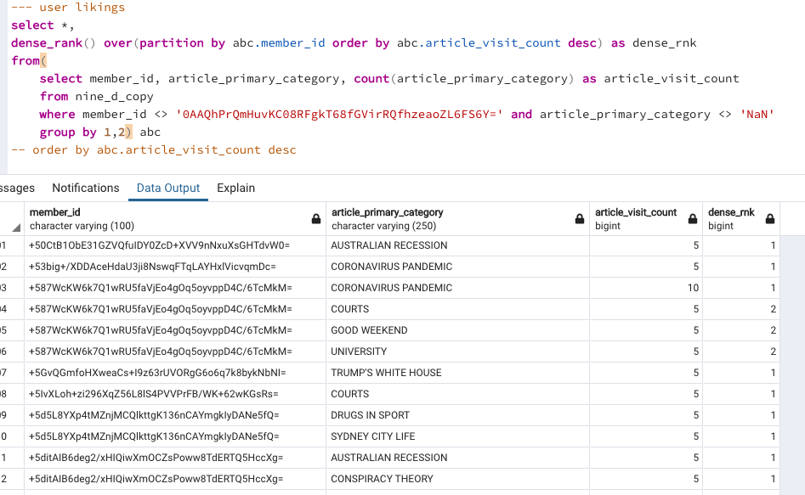
User likings
User likings per user

Slide 7
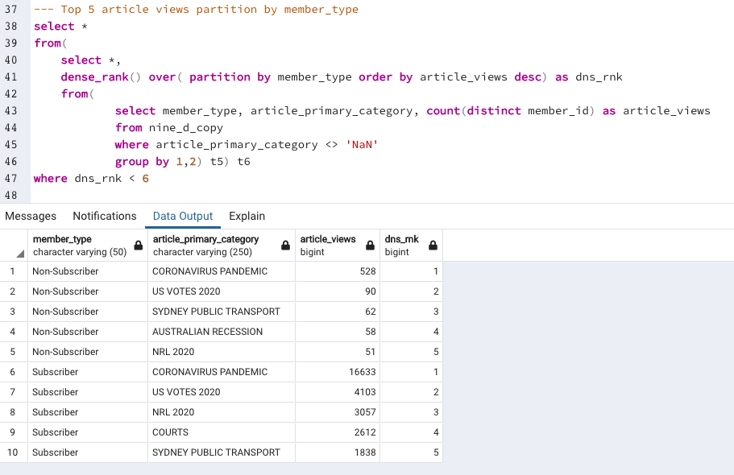
User likings
User likings according to their member type

Slide 8
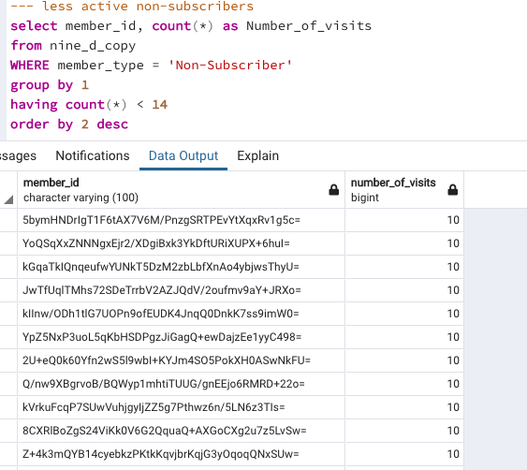
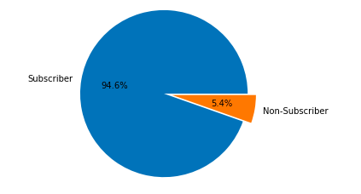
Less active non-subscribers
60000 Unique members
3200 Non-subscribers
2698 users

Slide 9
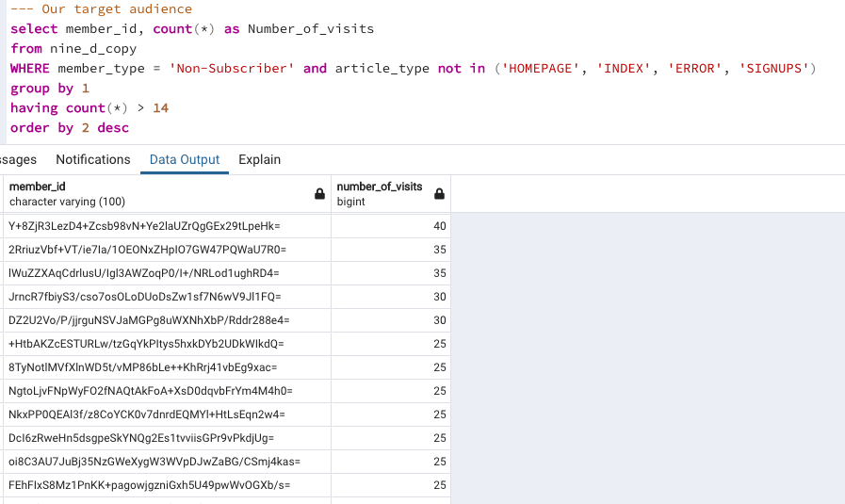
Potential future subscribers
68 members

Slide 10
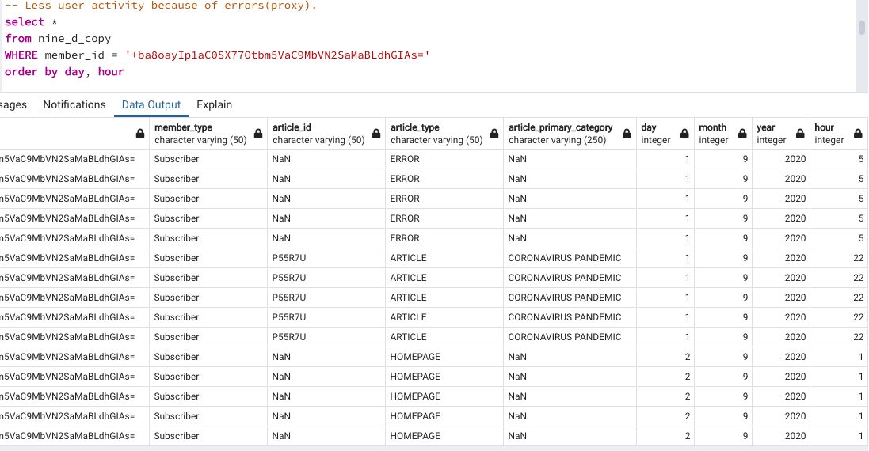
Skewing audience

Slide 11
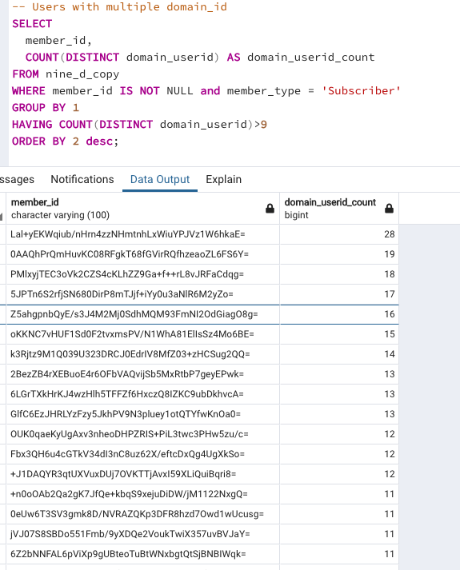
Shared subscriber accounts
1. The person associated with a specific member_id is visiting the website from different devices (for example a home and work computer).
2. The person associated with a specific member_id is visiting the website in different browsers (for example Chrome and Safari), potentially on multiple devices.
3. The person associated with a specific member_id is always visiting the website from the same device and browser, but the cookies in that browser have been reset, forcing a new domain_userid to be assigned.
Ref: https://discourse.snowplowanalytics.com/t/identifying-users-identity-stitching/31

Slide 12
Thank you

